Slide 1



UNIT 3;
Trends
Lesson 5; Perfecting humans

Slide 2
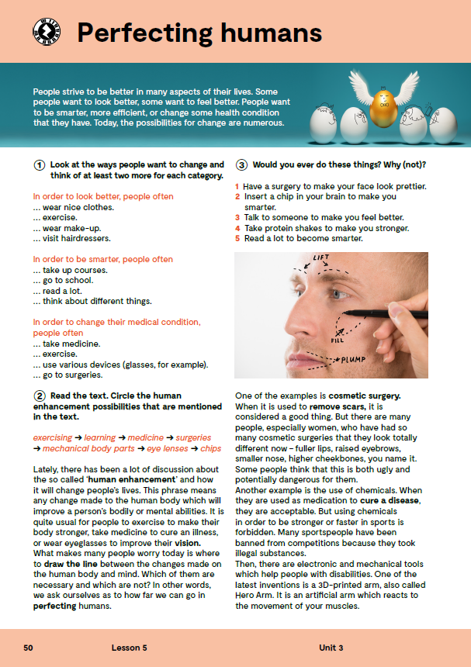
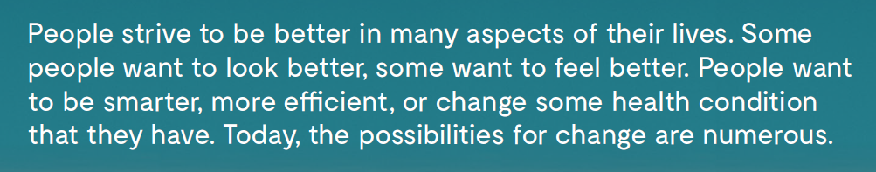
Do you know the meaning of these expressions?
strive
surgery
implant
chemicals
enhancement
mental abilities
vision
remove scars
eyebrows
cheekbones
cure a disease
to be banned
illegal substances
težiti
operacija
ugraditi
kemikalije
poboljšanje
mentalne sposobnosti
vid
uklanjanje ožiljaka
obrve
jagodice
izliječiti bolest
biti zabranjeno
ilegalne supstance

Slide 3

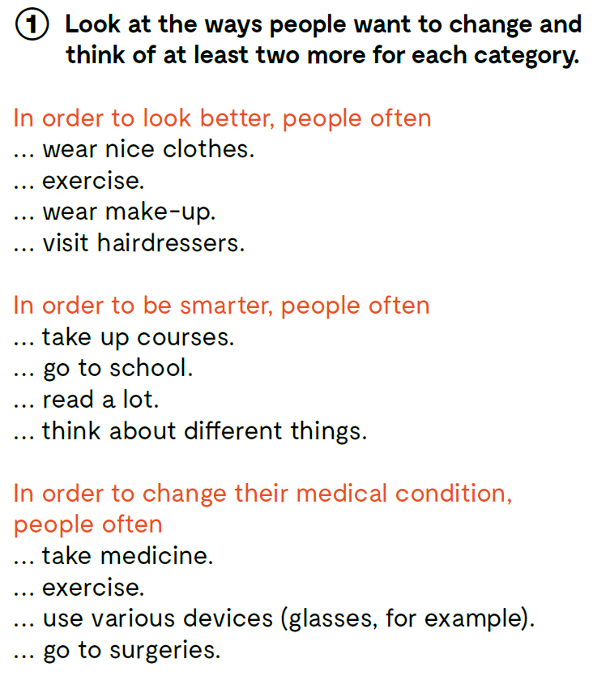

Slide 4
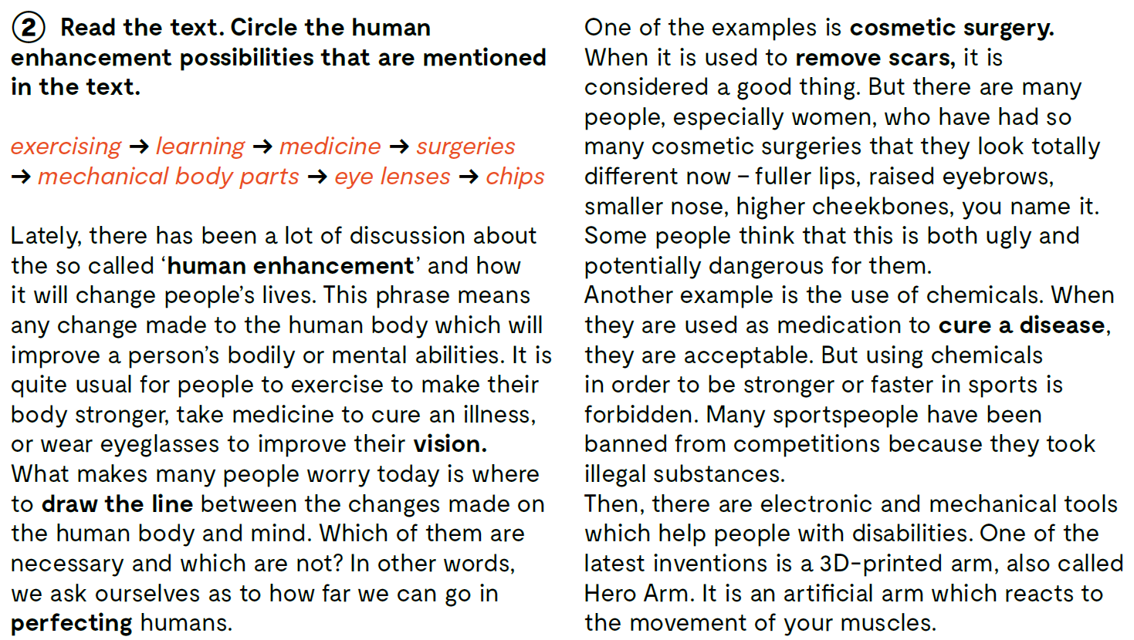

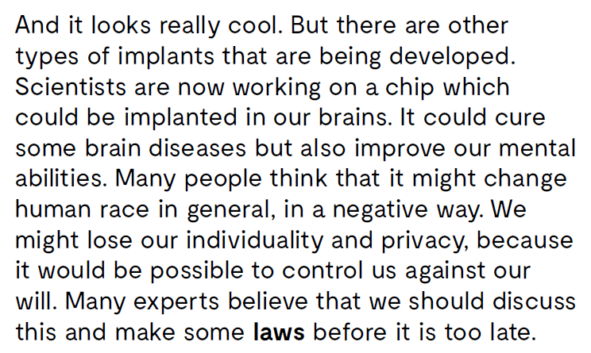
Read the text. Circle the human enhancement possibilities that are mentioned in the text..

Slide 5
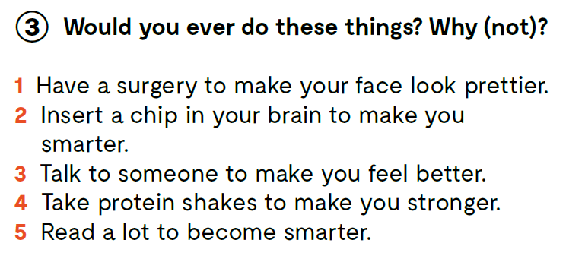

Slide 6
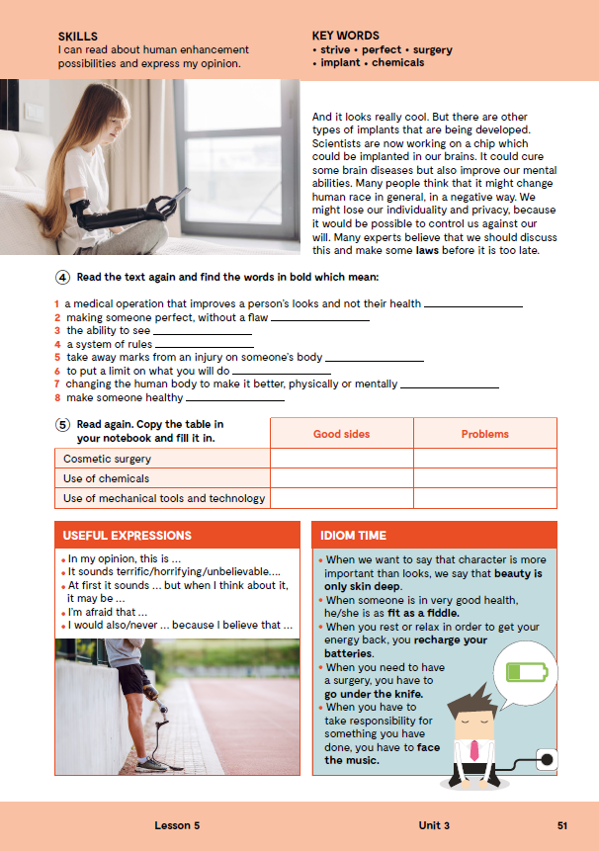
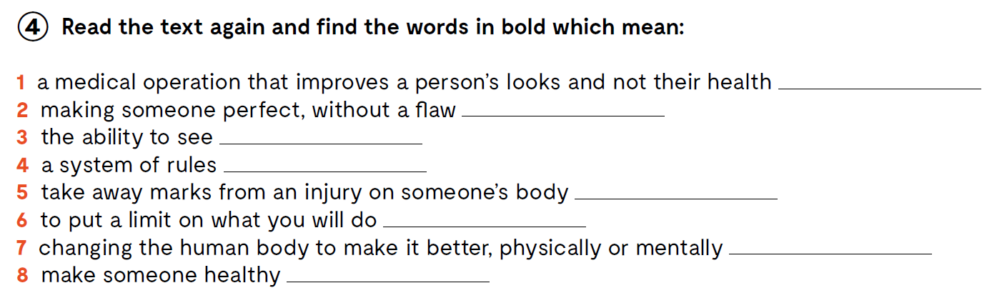
cosmetic surgery
perfecting
vision
laws
remove scars
draw the line
human enhancement
cure a disease
Check what you have learnt. https://wordwall.net/resource/24702403

Slide 7
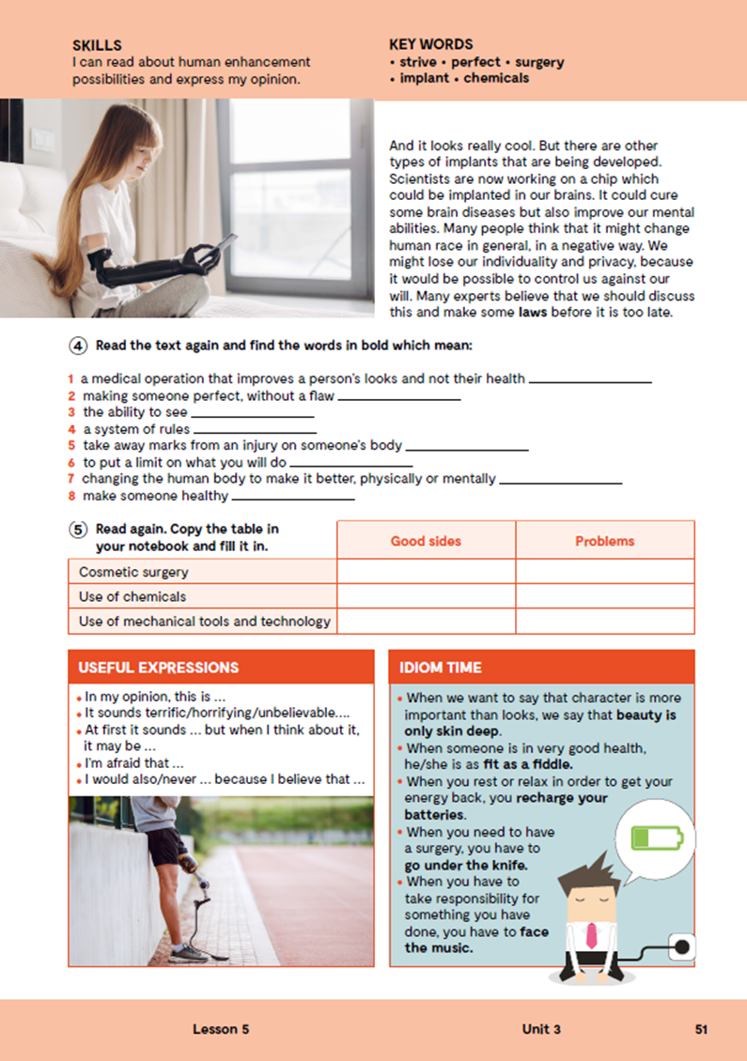
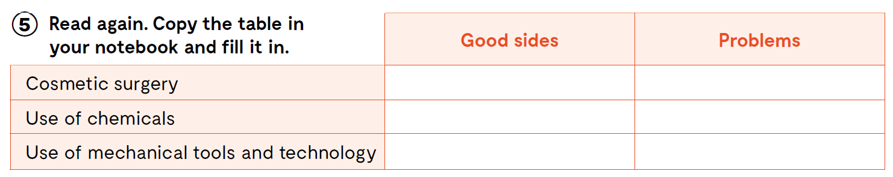

Slide 8
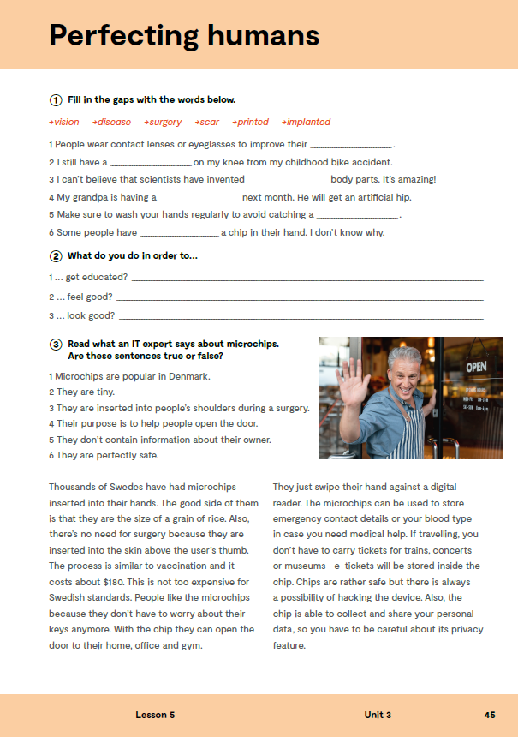
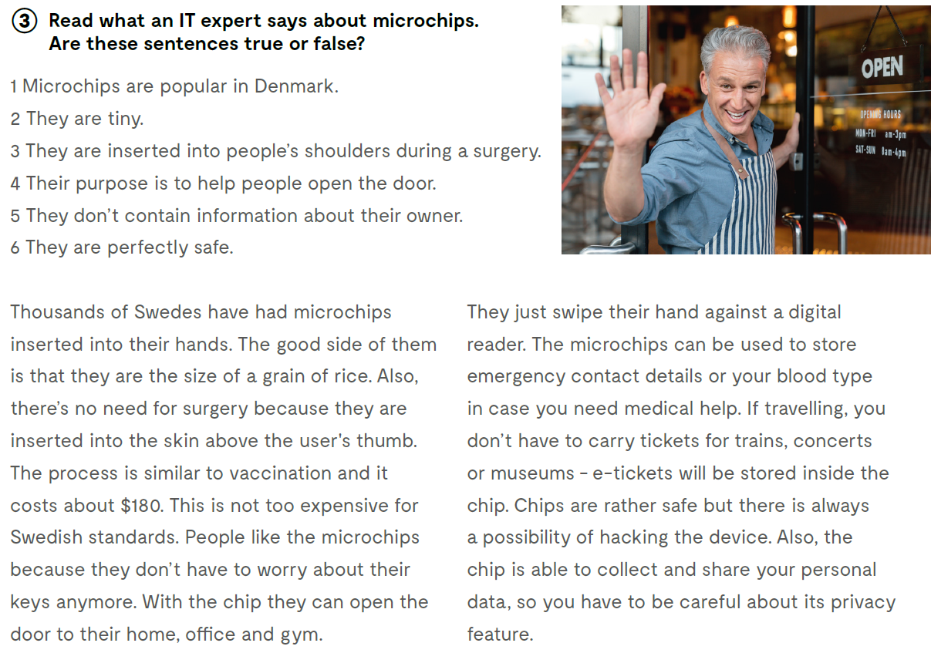
workbook, page 45.
F
T
F
T
F
F

Slide 9
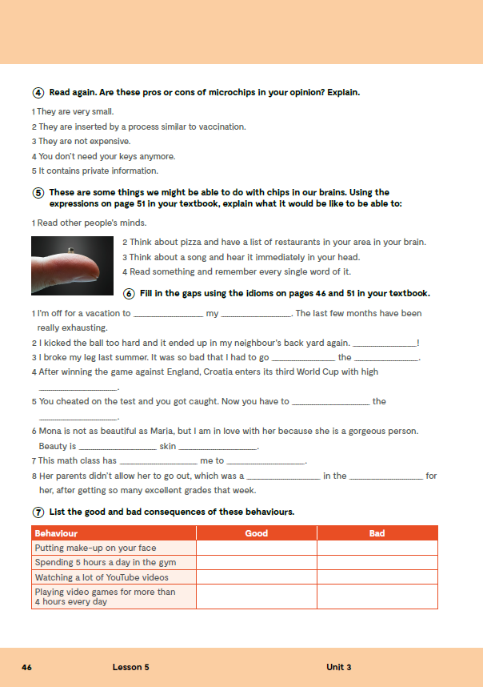
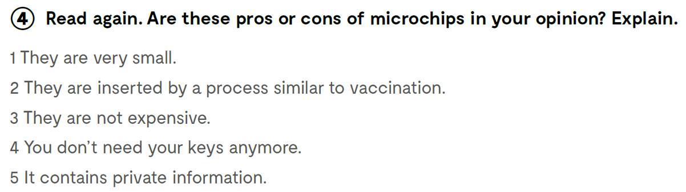

Slide 10
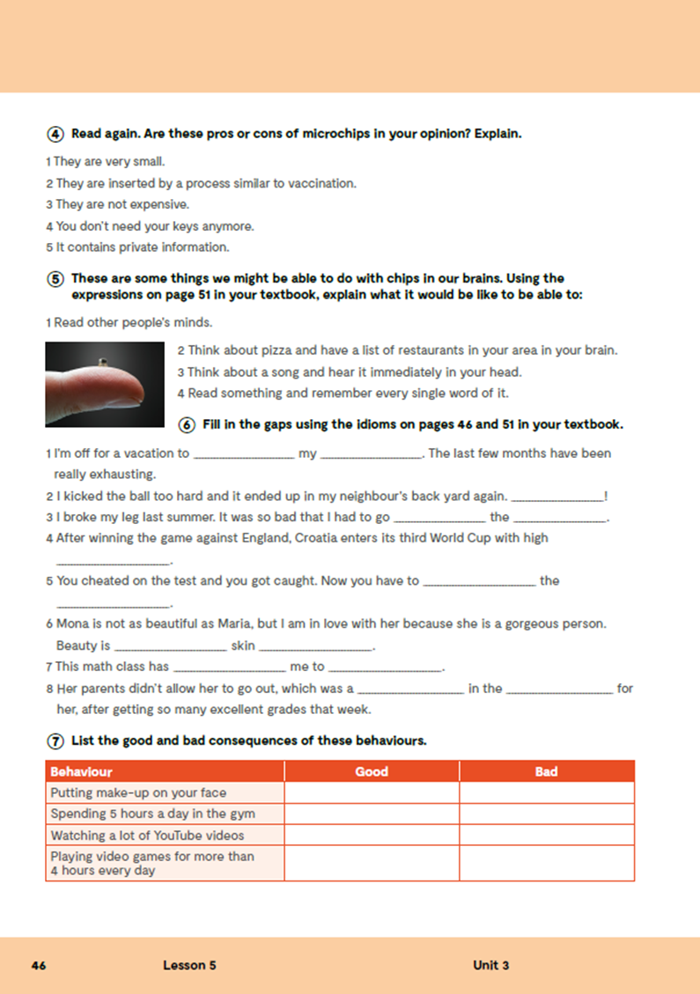
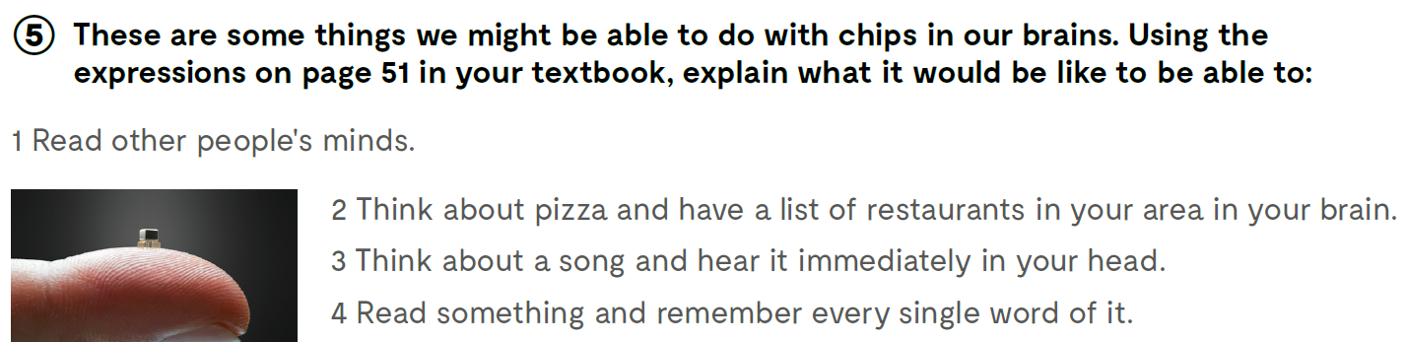
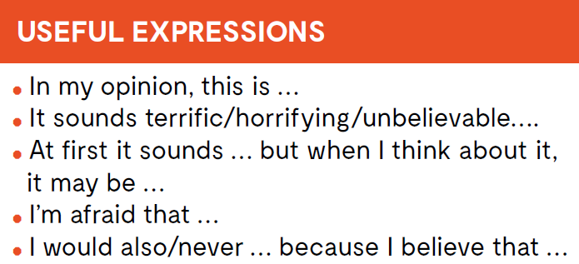


Slide 11

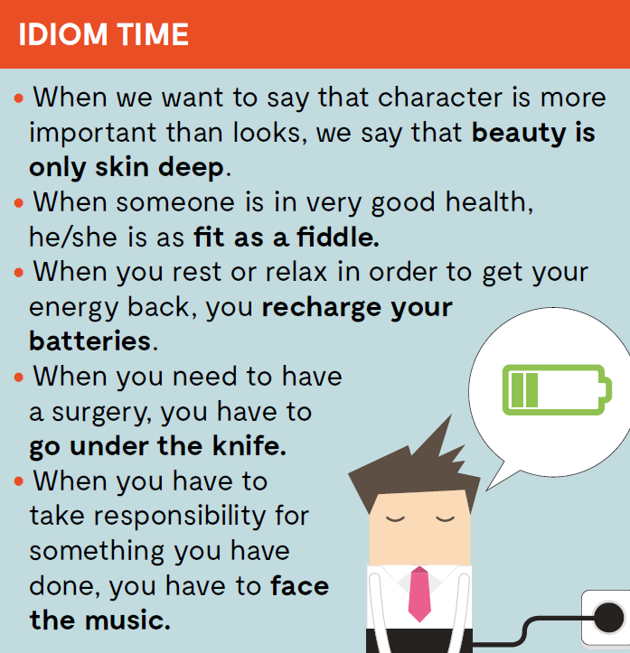

Slide 12
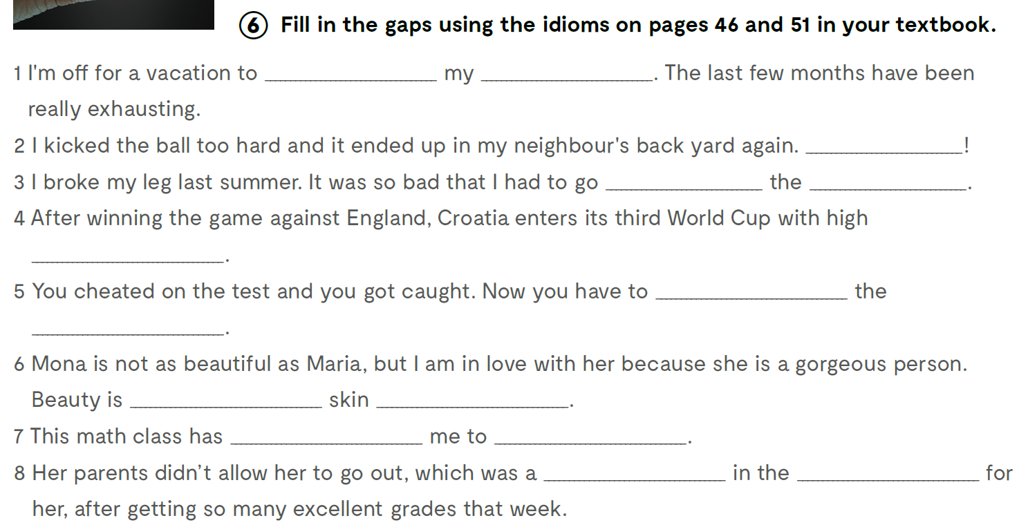
workbook, page 46.
recharge
batteries
Bummer
under
knife
hopes
face
music
only
deep
bored
death
kick
teeth

Slide 13
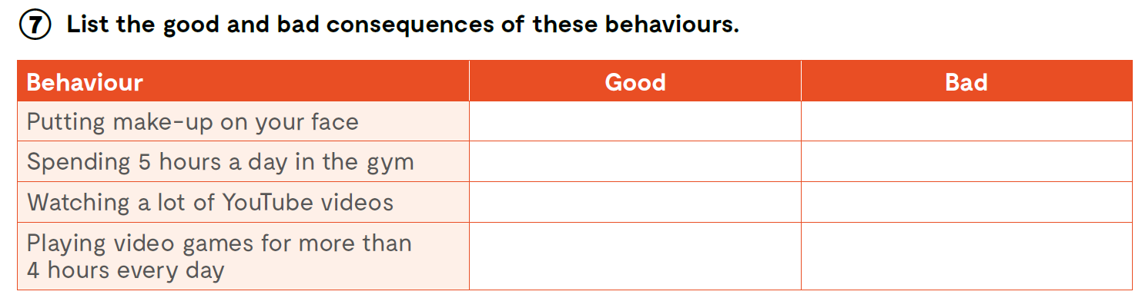

Slide 14
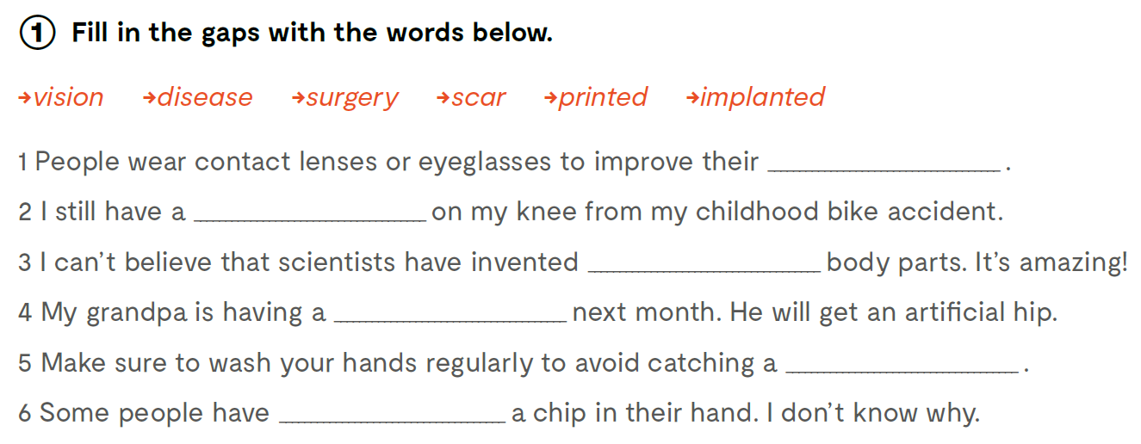
vision
scar
printed
surgery
disease
implanted
Check what you have learnt. Provjeri što si naučio: https://www.bookwidgets.com/play/VB9C2V9

Slide 15

